Slide 1
ADORE- Aspect Dependent Online REview Labeling for Review Generation
Source: SIGIR’ 20
Speaker: Tzu-Yun Chien
Advisor: Jia-Ling Koh
Date: 2021/03/29

Slide 2
Outline
Introduction
Method
Experiment
Conclusion

Slide 3
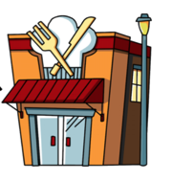
Motivation
The meat was amazing and the salad had a delicious dressing.
The price is very reasonable for a family of four.
Very few users take the time to write helpful reviews !!

Slide 4
Aspect-aware review generation
(Aspect, Sentiment)
Review
Food, +
The meat was amazing and the salad had a delicious dressing.
Price, +
The price is very reasonable for a family of four.
Problem: data bottleneck
- lack of labeling at, (1) aspects
(2) sentiment associated with these aspects

Slide 5
Aim(s)
Propose a labeling method, Aspect Dependent Online REviews (ADORE), leverages a small seed set of labeled data to create an aspect-aware review dataset.
Propose a joint model that learns to generate aspect-aware reviews.

Slide 6
Framework
Review labeling
(ADORE)
Aspect-aware review generation
STEP 1: Review Segmentation
STEP 2: Label Assignment

Slide 7
STEP 1: Review Segmentation
Input: a review, R
Drinks were pretty good. The server, was friendly and accommodating. very happy with her.
In summation, a great pub experience. would go again !
Output: segments
Drinks were pretty good. The server, was friendly and accommodating. very happy with her.
In summation, a great pub experience. would go again !

Slide 8
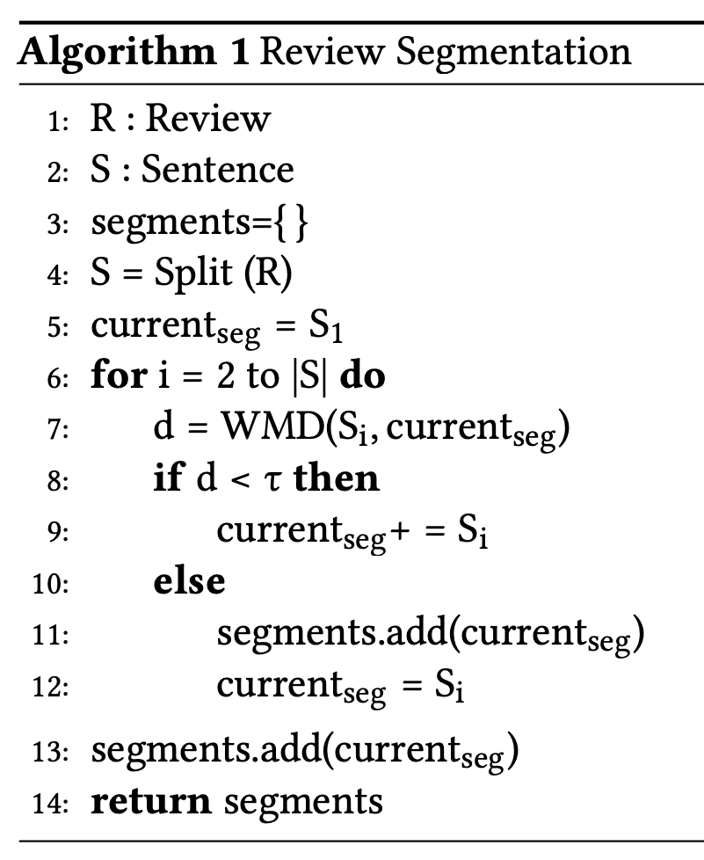
STEP 1: Review Segmentation
Input: a review, R
Drinks were pretty good. The server, was friendly and accommodating. very happy with her.
In summation, a great pub experience. would go again !

Slide 9
STEP 1: Review Segmentation
Input: a review, R
S1: Drinks were pretty good.
S2: The server, was friendly and accommodating.
S3: very happy with her.
S4: In summation, a great pub experience.
S5: would go again !

Slide 10
STEP 1: Review Segmentation
Input: a review, R
S1: Drinks were pretty good.
S2: The server, was friendly and accommodating.

Slide 11
STEP 1: Review Segmentation
Input: a review, R
1) Remove stop words & punctuation marks
S1: drinks pretty good
S2: server friendly accommodating

Slide 12
STEP 1: Review Segmentation
Input: a review, R
2) Calculate Word Mover’s Distance (WMD)
$$W_{ij} :the weight of word based on nBOW$$
S1: drinks pretty good
[0.33, 0.33, 0.33]
[0.33, 0.33, 0.33]
S2: server friendly accommodating

Slide 13
STEP 1: Review Segmentation
Input: a review, R
2) Calculate Word Mover’s Distance (WMD)
$${c(w}_{i} ,w_{j}):Euclidean distance between two words$$
[0.33, 0.33, 0.33]
S1: drinks pretty good
1.65
0.66
5
2
3.3
10
S2: server friendly accommodating

Slide 14
STEP 1: Review Segmentation
Input: a review, R
2) Calculate Word Mover’s Distance (WMD)
$${c(w}_{i} ,w_{j}):Euclidean distance between two words$$
[0.33, 0.33, 0.33]
S1: drinks pretty good
3.3
6.6
0.33
S2: server friendly accommodating

Slide 15
STEP 1: Review Segmentation
Input: a review, R
2) Calculate Word Mover’s Distance (WMD)
S1: drinks pretty good
d = 0.66 + 0.33 + 0.33 = 1.32
S2: server friendly accommodating

Slide 16
STEP 1: Review Segmentation
Input: a review, R
S1: Drinks were pretty good.
Seg1
S2: The server, was friendly and accommodating.
S3: very happy with her.
S4: In summation, a great pub experience.
S5: would go again !
Repeat 1 and 2

Slide 17
STEP 1: Review Segmentation
Input: a review, R
S1: Drinks were pretty good.
Seg1
S2: The server, was friendly and accommodating.
S3: very happy with her.
S4: In summation, a great pub experience.
S5: would go again !
Seg2
Seg3

Slide 18
STEP 2: Label Assignment
Input: segments
Drinks were pretty good. The server, was friendly and accommodating. very happy with her.
In summation, a great pub experience. would go again !
Output: segments with label
Drink, +
Ambience, +
Drinks were pretty good. The server, was friendly and accommodating. very happy with her.
In summation, a great pub experience. would go again !
General, +

Slide 19
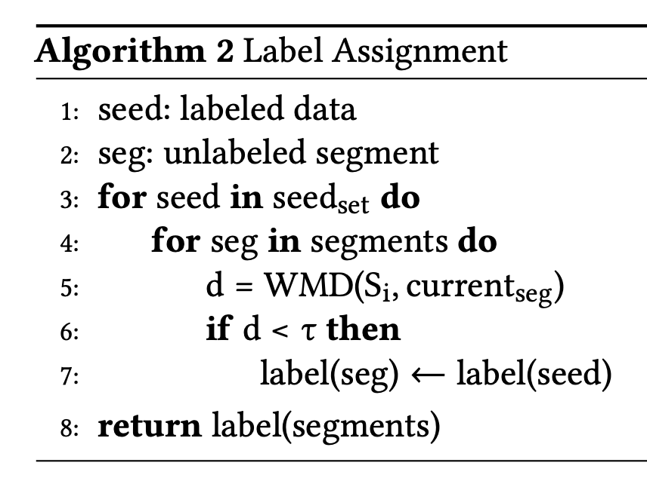
STEP 2: Label Assignment
Input: segments
Drinks were pretty good.
Seg1
The server, was friendly and accommodating.
very happy with her.
Seg2
In summation, a great pub experience.
would go again !
Seg3
Labels (10)
Food (+,-)
Ambience (+,-)
Price (+,-)
Drink (+,-)
General (+,-)
Seed set:
Drink, +
Beer was all good.

Slide 20
STEP 2: Label Assignment
Input: segments
Drinks were pretty good.
Seg1
Seed set:
Drink, +
Beer was all good.
Labels (10)
Food (+,-)
Ambience (+,-)
Price (+,-)
Drink (+,-)
General (+,-)
1) Remove stop words & punctuation marks
2) Calculate Word Mover’s Distance (WMD)

Slide 21
Framework
Review labeling
(ADORE)
Aspect-aware review generation
STEP 1: Review Segmentation
STEP 2: Label Assignment

Slide 22
Aspect-aware review generation
Encoder
$$drinks$$
Decoder
$$z_{i}$$
GRU
…
Aspect Encoder
…
…
…
…
GRU
GRU
…
$$Aspect A$$
…
$$<sor>$$
$$drinks$$
$$good$$

Slide 23
Aspect-Encoder
Convert aspect into one-hot vector
Encode the input aspect
$$z_{i}$$
Aspect Encoder
$$aspect embedding$$
$$Aspect A$$

Slide 24
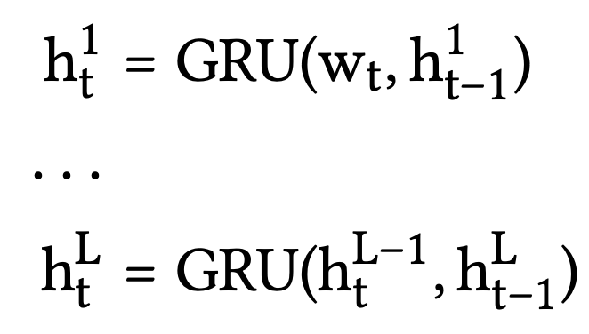
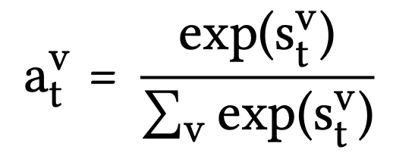
Attention-based Review Generator
Output
L-layer GRU
$$drinks$$
$$h_{t}^{L}$$
$$a_{t}^{v}$$
$$h_{t}^{L}$$
GRU
…
$$z_{i}$$
$$h_{t−1}^{L}$$
$$h_{t}^{L−1}$$
Attentive weight
…
…
…
…
GRU
$$h_{t}^{1}$$
$$z_{i}$$
GRU
…
$$h_{t−1}^{1}$$
$$w_{t}$$
…
$$<sor>$$
$$drinks$$
$$good$$

Slide 25
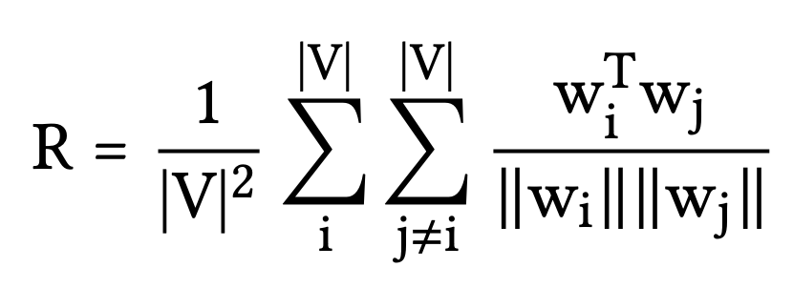
Loss Function
Cross-entropy loss
$$+ R$$
Aggregate cosine similarity

Slide 26
Dataset
Seed data - SemEval challenge (2016)
Yelp (2019)
Yelp restaurant reviews. It has about 4M reviews for about 60k restaurants.

Slide 27
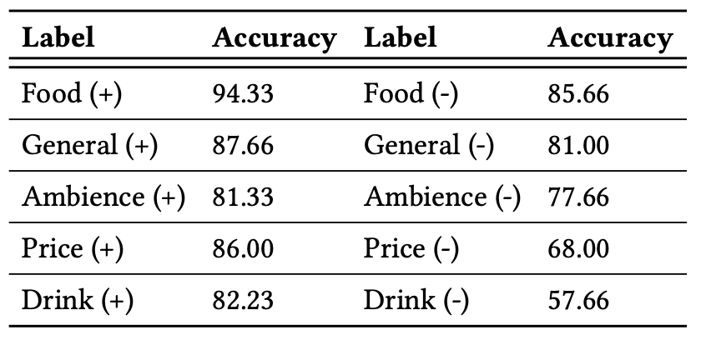
Evaluation of Labeling Methodology
Determining the distance threshold ($τ$)
Performance of the ADORE labeling

Slide 28
Evaluation of Labeling Methodology
The performance across different segmentation algorithms
The probability of segmentation error :

Slide 29
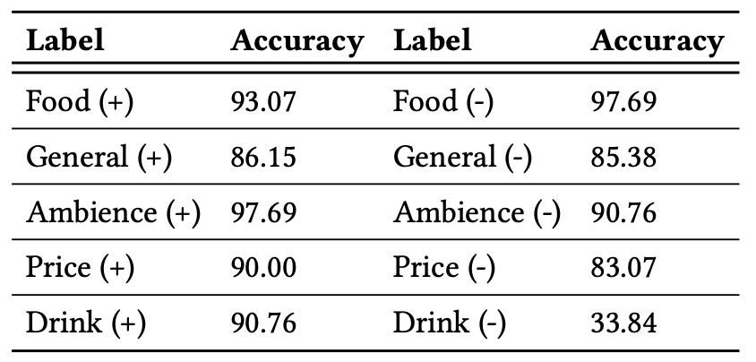
Evaluation of Generative Model
Generated reviews stay with the desired aspect

Slide 30
Evaluation of Generative Model
The impact of diversity-enforcing regularizer

Slide 31
Conclusion
Develop a labeling methodology to build an aspect-aware review dataset and evaluate the effectiveness of our approach using crowd-sourced annotation.
Propose a joint model that learns to generate aspect-aware reviews in an end-to-end manner.

